Slide 1

Introducción: Qué es Data Science?

Slide 2
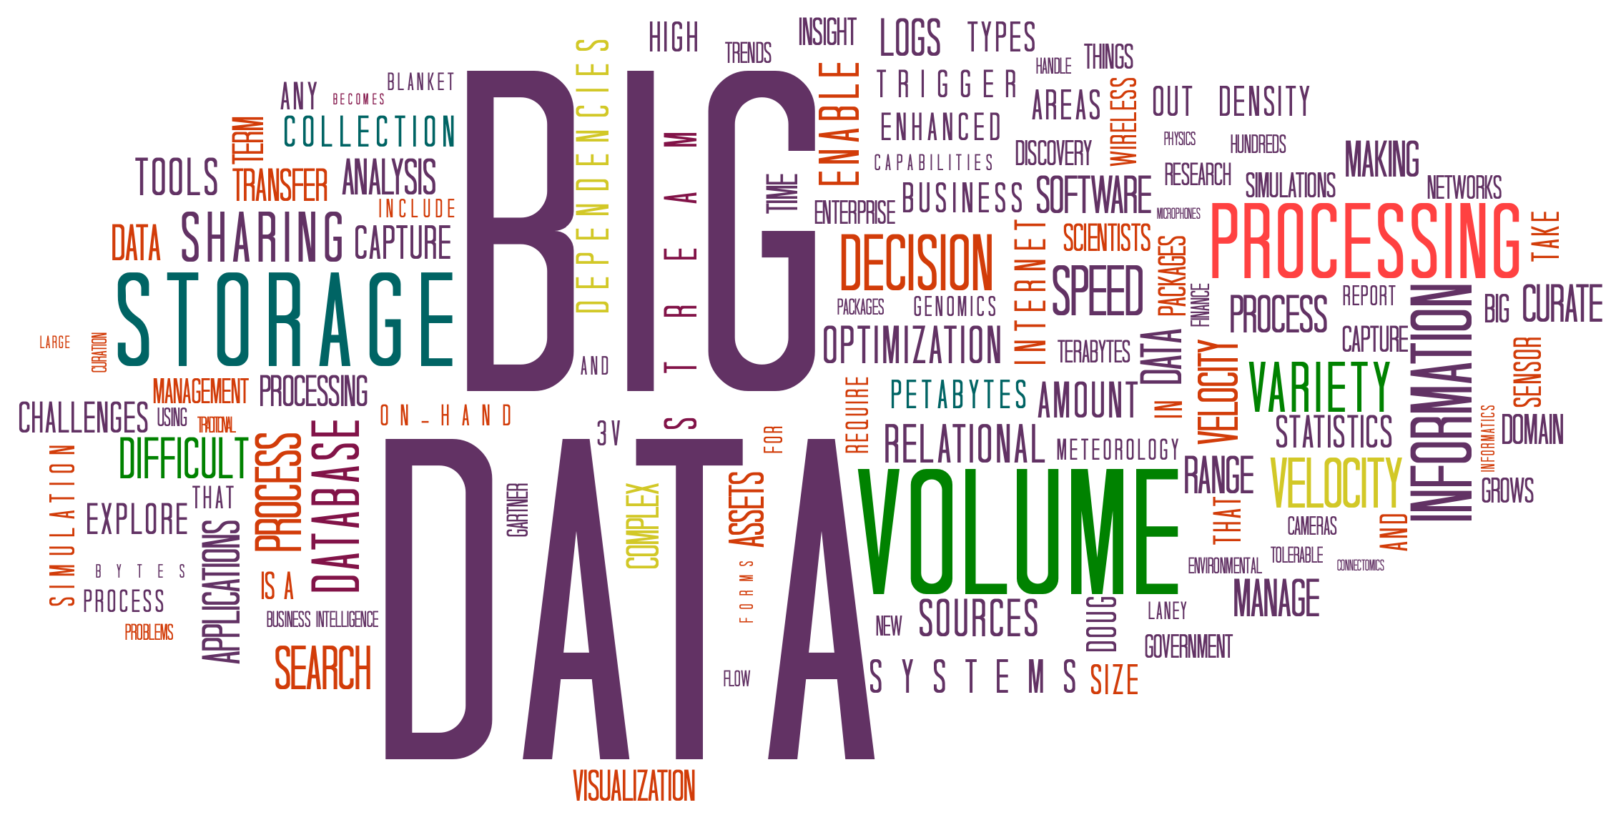
Motivación para el Curso: Datos están Dirigiendo Todo
La adquisición de datos moderna es económica!
Smartphones, sistemas embebidos, sensores económicos,
Dispositivos médicos, simuladores, …
El almacenamiento de datos es económico !
Computación paralela es económica (compute cluster)
Cloud, clusters de computadores, GPUs, procesadores tensor, …
Podriamos usar algoritmos + datos para entender fenómenos? Construir o aumentar modelos? Construir detectores? Hacer diagnosticos?
Notes:
There is data everywhere. It is constantly being collected (e.g. through smartphones, IoT sensors, Alexa) and contributed (e.g. through Facebook and Twitter). Storage is cheap, and compute power readily available and rapidly increasing. Computer clusters are available to enable parallelism, and special architectures developed for ML operations. All this is available not just for those who can afford to own them but through the commodity of the cloud..
This increased ability to collect, store and process data has led to a revolution in how we do things in almost every field, from biological sciences to social sciences, humanities, political science, policy, marketing and so on. But just because we have the data doesn’t imply we understand it. It must be processed to derive information, make models, enable predictions, and make diagnoses. We want to use the data to develop (or augment) models using machine learning and other algorithms.
That is the essence of this course.

Slide 3
La pregunta clave en Data Science: Cómo explicar & Predecir el mundo?
Muchas de las ciencias y la ingenirí derivan de las ciencias físicas, donde se tienen modelos predictivos enriquecidos
Leyes de Newton, Teoría de la Relatividad, cómo reaccionan los materiales ópticos bajo estímulos, etc.
La base de la predicción es la simulación
Cómo hacer predicciones donde no se tienen buenos modelos?
E.j., comportamiento humano, biología, el cerebro, si un producto será un éxito, en qué invertir
Necesitamos utilizar métodos de muestreo, estadísticas y el enfoque"primero los datos"
¡Pero necesitamos suficientes datos representativos y las preguntas correctas para obtener buenos modelos!
Por supuesto, en el mundo real a menudo queremos combinar modelos y datos!
Notes:
The desire to make sense of the world is not new. In several domains (e.g. physics), well defined models have been developed which have for years been used to make predictions. The novelty in Data Science is the ability to create – or refine -- models in domains where the underlying principles may not be understood.

Slide 4
Contenido
Qué es Data Science?
Consideraciones sobre big data
¿Qué implica Data Analitycs?
Resumen
Ejercicios
Práctica

Slide 5
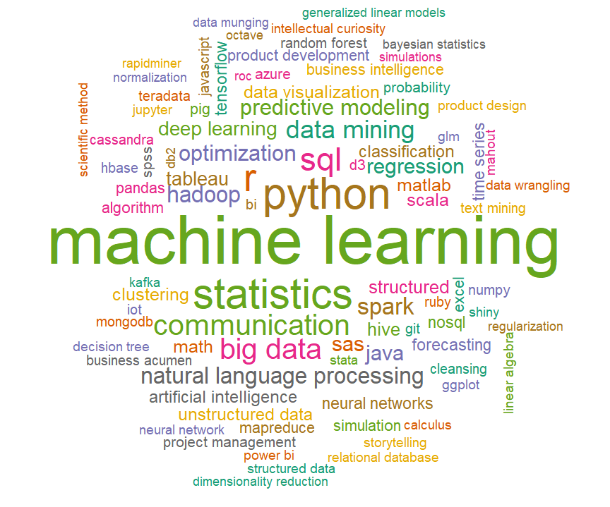
Nube de palabras para Data Science
Notes:
If you do a word cloud for Data Science you get something like this. Machine Learning is of course very important, as are statistical techniques, languages (e.g. Python and R), tools (e.g. Hadoop, Kafka), databases (SQL, MongoDB), visualization (e.g. using Tableau and D3), etc.
The idea is that machine learning is part of a much bigger ecosystem, and must be used at scale.

Slide 6

Data Science es Interdisciplinario
(CIENCIAS DE LA COMPUTACIÓN+ESTADÍSTICA+MATEMATICA) ∩
(CIENCIA | ECONOMIA | SOCIOLOGIA | NEGOCIOS | LEYES…)
Notes:
Missing in this wordcloud, however, is how inherently interdisciplinary Data Science is. It requires domain experts to understand what/where the data is and what questions are important to ask; mathematicians and statisticians to understand modeling and inference; computer scientists to build systems and design algorithms and methods for analysis; visualization experts and storytellers to effectively communicate results, and policy and legal experts to understand the broader social context, e.g. the ethical implications of a field that has such a dramatic effect on every aspect of our lives (getting a job, job evaluation, what ads are served up, etc).
Data science takes ideas from computer science+math+statistics and applies them (∩) to problems in science, economics, sociology, business, law or …

Slide 7
Data Science vs Data Analytics y Data Engineering
Este curso se enfocará inicialmente en los aspectos técnicos y de manipulación de datos de Data Science, que llamaremos "Análisis de datos".
Algunas personas también lo llaman data engineering
Data Science es mucho más amplia e incluye experiencia en el dominio, comunicación de los resultados a los usuarios a través de la narración (storytelling) y visualización, e implicaciones políticas y legales.
Más adelante podemos considerar un contexto social más amplio, Ej. Ética de los datos
Privacidad, equidad, responsabilidad, transparencia, …
A lo largo del curso daremos ejemplos de cómo se usa Data Science en diferentes dominios.
Notes:
But of course, understanding the domain well requires an expert – which is outside the scope of this course!

Slide 8
Data Analytics
Nuestro enfoque: gestión y creación de modelos a partir de datos a escala:
Complejidad, heterogéneidad, volumen, alta dimensionalidad, velocidad.
Abordaremos muchas técnicas y problemas relacionados
machine learning, computación distribuida, algoritmos distribuidos y computación paralela.
Aprovecharemos las herramientas y plataformas estándar y apuntaremos a otras
Nuestro enfoque está en los fundamentos de machine learning y platformas cloud– ¡Deberías seguir estudiándolos en profundidad después!

Slide 9
Datos y Modelos
Datos Duros
Observaciones tomadas del mundo real
Datos Estructurados e Integrados
Máquina que interpreta datos
Extracción de Características (Features)
Características Medibles
Modelo Descriptivo o Inferencial
De la población como un todo
Parte de los datos pueden estar:
En diferentes sistemas u organizaciones
A través de diferentes documentos, bases de datos, etc.
Además, a menudo no está en una forma en la que:
Podemos usarlos directamente, por ejemplo, en documentos de texto o HTML.
Es limpio y regular, por ejemplo, tiene valores faltantes, valores falsos, etc.
Nuestro objetivo es extraer características que nos ayuden a hacer predicciones.
Notes:
This is the typical workflow for Data Analysis: Raw data is obtained and must be cleaned and regularized. We may also want to complement is using other data which much also must be cleaned and regularized. The data (which may come from different organizations and be in different formats) must then be integrated and put it in a form it which features can be extracted to help make predictions.
We’ll talk about the first two steps next.

Slide 10
Consideraciones sobre Big Data: Estructura, Limpieza, y Enlace

Slide 11
Mundos Abiertos y Cerrados, Observaciones vs el Universo
Las bases de datos a menudo son un mundo cerrado: lo sabemos todo …
Los empleados de la empresa, sus salarios exactos, cada producto, …
Data science está en un mundo abierto: no podemos ver a toda la población.
Se nos dan muestras u observaciones incompletas.
Queremos predecir el futuro o caracterizar a toda la población
La forma en que tomamos muestras afecta a nuestro modelo!
Hay muchas trampas que pueden conducir a modelos sesgados, un tema que los investigadores están tratando de abordar!
Como dice la SEC: "El rendimiento pasado no es indicativo de resultados futuros"
Notes:
Sampling is one of the most important factors in determining the accuracy of results. Is a well studied area that requires collaboration between the domain scientist and statisticians. In Data Science, however, data might be collected for one purpose and reused for other purposes, so there are additional issues of how representative the data is for the given research question. In a later module, we will briefly consider this issue.
For now, we will assume that the data has been collected, and will consider what must be done to put it in a form in which analysis can be performed.

Slide 12

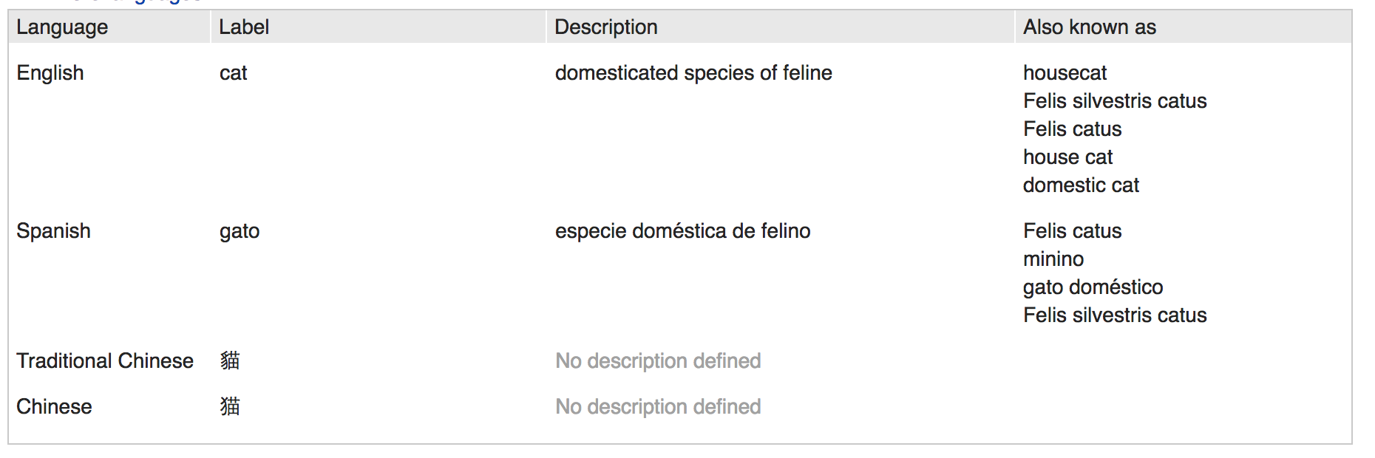

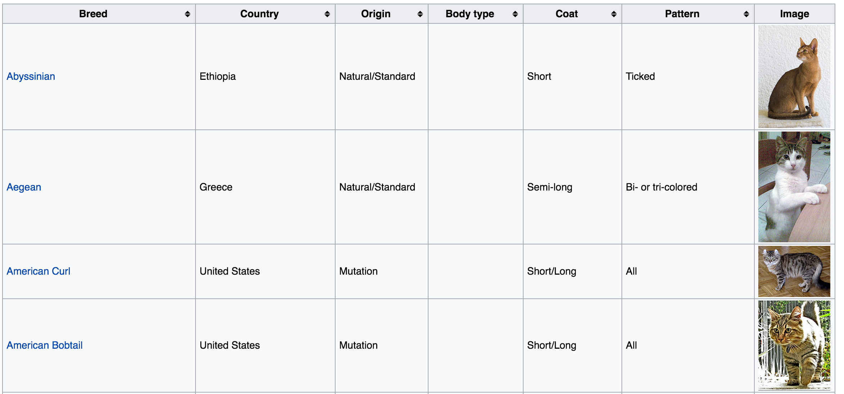
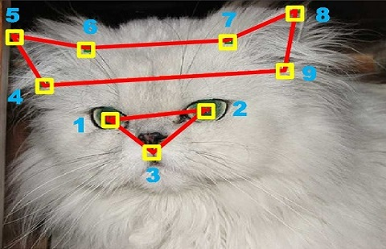
Datos Duros vs Datos Estructurados
Imgenes
Datos +
Extracción de características, wrangling
Genes
Texto
No seas como el gato que quiso un pez
pero tenía miedo de mojarse las patas.
William Shakespeare
Notes:
Let’s take the popular example of cats – everyone loves information you can find about cats on the internet!
For example, there are images, genomic information, articles about cats (free text and/or semi-structured information).
We want to be able to bring it all together, wrangle it, and bring it into a form that can, for example, be used to develop a model for recognizing various types of cats.
Credits: Wikipedia, https://people.eecs.berkeley.edu/~junyanz/cat/cat_papers.html,

Slide 13
Datos Duros vs Datos Estructurados
Imgenes
Datos +
Extracción de características, wrangling
Genes
Texto
Objetivo: datos duros a datos estructurados
Campos, entidades, objetos, machine learning features
Puede ser muy regular o semi-estructurado
En última instancia, el objetivo es pasar de los datos a la información y al conocimiento.
No seas como el gato que quiso un pez
pero tenía miedo de mojarse las patas.
William Shakespeare
Notes:
Let’s take the popular example of cats – everyone loves information you can find about cats on the internet!
For example, there are images, genomic information, articles about cats (free text and/or semi-structured information).
We want to be able to bring it all together, wrangle it, and bring it into a form that can, for example, be used to develop a model for recognizing various types of cats.
Credits: Wikipedia, https://people.eecs.berkeley.edu/~junyanz/cat/cat_papers.html,

Slide 14
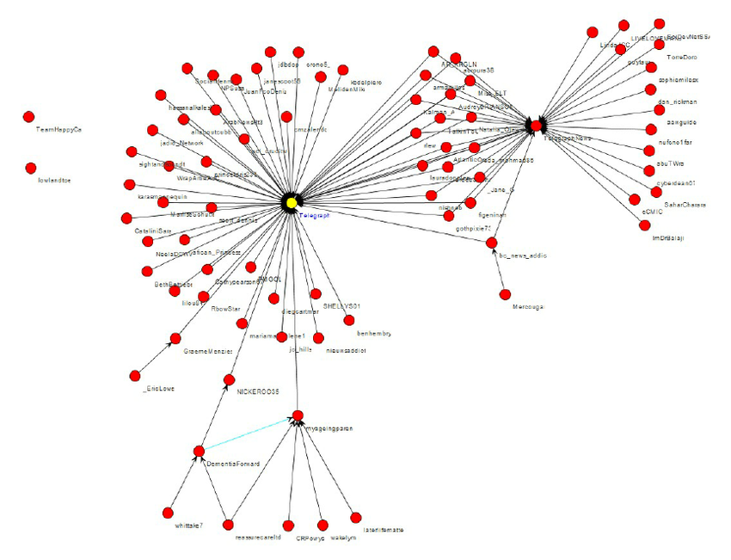
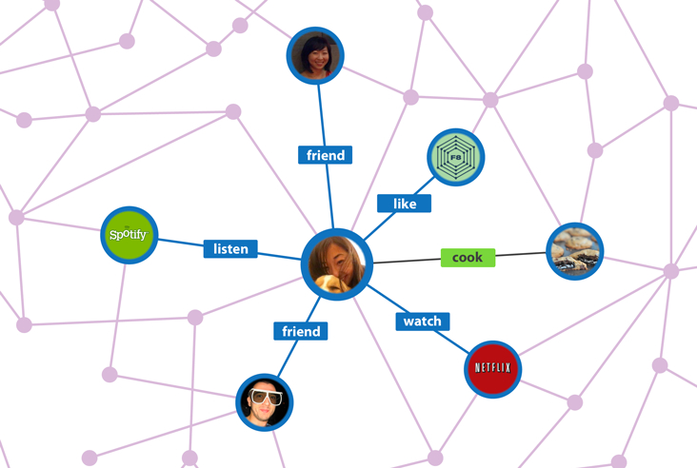
Linked Data: Find Patterns in Connectivity (Clusters, Paths, …)
Notes:
We’ve been talking a lot about “entities” (real world objects) and features of entities, but sometimes it is the relationships between entities that are important (e.g. friend relationships in Facebook). We commonly represent relationships between entities as a graph, with nodes being the entities and edges being the relationships. We can then use the relationships to make recommendations, for example, who you might friend, or what type of music you might like to listen to. In doing so, you might look at properties of enties as well as paths between entities, or connected components of entities. So there are a lot of algorithms that we might want to run over these graphical models. This applies well beyond social networks to areas such as genomics.
Facebook graph: https://www.google.com/url?sa=i&rct=j&q=&esrc=s&source=images&cd=&cad=rja&uact=8&ved=0ahUKEwiG-NS3pszYAhUiYt8KHUMFCH4QjRwIBw&url=http%3A%2F%2Fwww.businessinsider.com%2Fexplainer-what-exactly-is-the-social-graph-2012-3&psig=AOvVaw2D5Cm84V0EKbfEKCIh2EYF&ust=1515635983002846
Retweet graph: https://www.researchgate.net/figure/266968024_A-sample-basic-retweet-graph

Slide 15
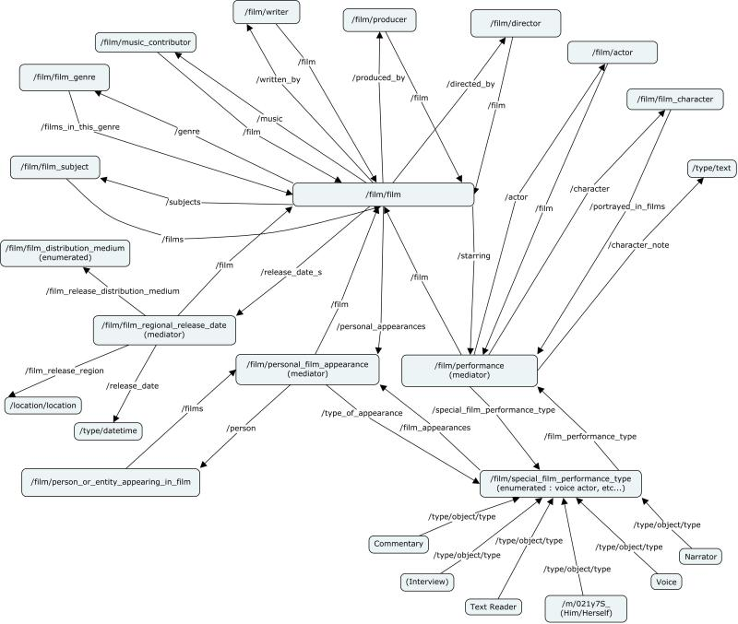
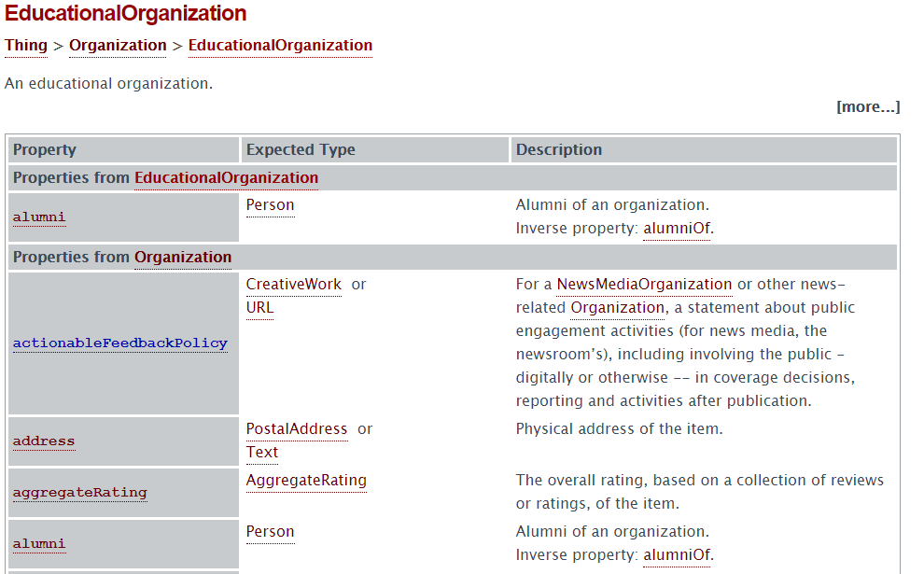
Datos con Complejidad Semántica: Grafos de Conocimiento
Clases, subclases, instancias, y propiedades
Notes:
There’s another type of graphical structure that is important called “knowledge graphs”. This is the centerpiece of what Google uses to aid search. It captures the concepts of a domain and the relationships between those concepts. For example, not shown in this image, we might have Barack Obama and Donald Trump at the leaves of a knowledge graph, and we know that there are certain things that those two people have in common, e.g. being president. Being president is a concept we could have in the knowledge graph, with Obama and Trump both being instances. We could also talk about some of their dissimilarities, e.g. being in different political parties. You can use the knowledge graph to disambiguate, and impose structure over the entities.
For example, a knowledge graph can and is being used to improve search. Suppose we are searching for Michael Jordan, and there are several different people named Michael Jordan (e.g. basketball player, actor, machine learning researcher). How does the system know which one you are talking about? There is a lot of information about you that your browser has been collecting: It could look at your search history and decide which one you are most likely to be interested in, e.g. Michael Jordan the machine learning researcher.
Freebase figure from: https://dzone.com/articles/associative-data-modeling-demystified-part-iv
EducationalOrganization from schema.org

Slide 16
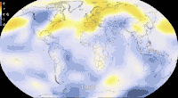
Datos dinámicos de alta velocidad: seguimiento a lo largo del tiempo, pronostica el futuro
Notes:
A third type of data that we will be talking about during the course is temporal data (which is also called timeseries or streaming data). Here we are not primarily interested in entities or relationships between entities, but how the data changes over time. In this image we are showing temperature data as it changes across the globe, which could be important if we are studying climate change. For example, we might worry about how the temperature in the ocean is rising and what the effect is over the ecosystem.
https://giphy.com/gifs/climate-change-visualization-global-warming-hPovBcQ3c1g9W

Slide 17
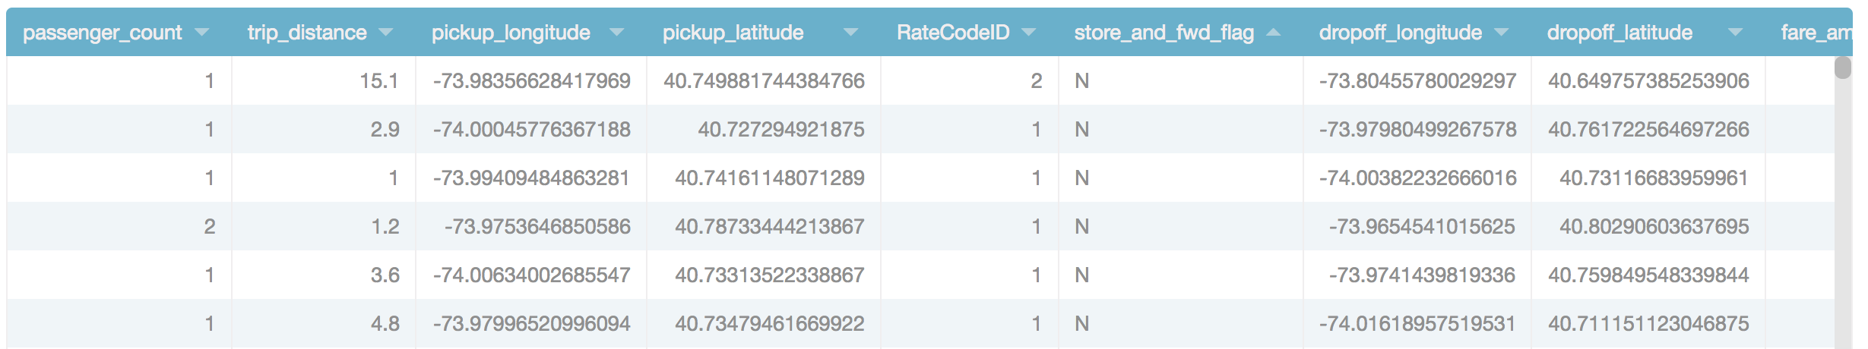
Datos Tabulados (Relacional) y Joins / Lookups (ej. Web Services)
New York Taxi Data
Notes:
Finally we should talk about tabular data. For example city governments are collecting a lot of data and making it publicly available, e.g. parking ticket and accident data. Frequently, questions you want to ask involve linking this data to other data. For example, here we have taxicab data with information about trips that people have taken, e.g. a taxi picked up a person and drove them for 15.1 miles. It also shows latitude-longitude data. You can infer certain things from this, such as the average length of trips, or the most frequent pickup location based on latitude-longitude. However, you can learn even more if you combine it with other information.
https://data.cityofnewyork.us/Transportation/2015-Yellow-Taxi-Trip-Data/ba8s-jw6u
Up next: How big? (Z)

Slide 18
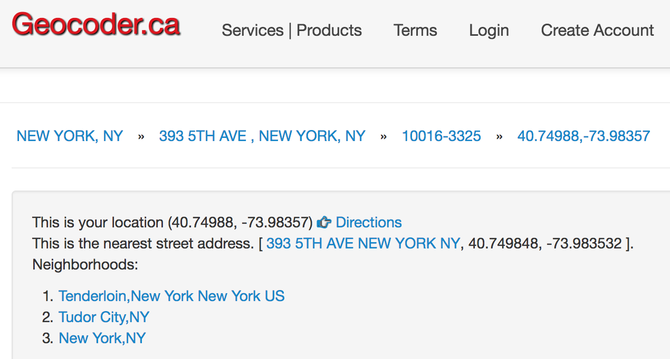
Datos Tabulados (Relacional) y Joins / Lookups (ej. Web Services)
New York Taxi Data
Datos de geocodificación inversa
Notes:
For example, Geocoder will take latitude-longitude and give street address information, which might be more meaningful to you.
https://data.cityofnewyork.us/Transportation/2015-Yellow-Taxi-Trip-Data/ba8s-jw6u
Up next: How big? (Z)

Slide 19
Datos Tabulados (Relacional) y Joins / Lookups (ej. Web Services)
New York Taxi Data
Datos de geocodificación inversa

Slide 20
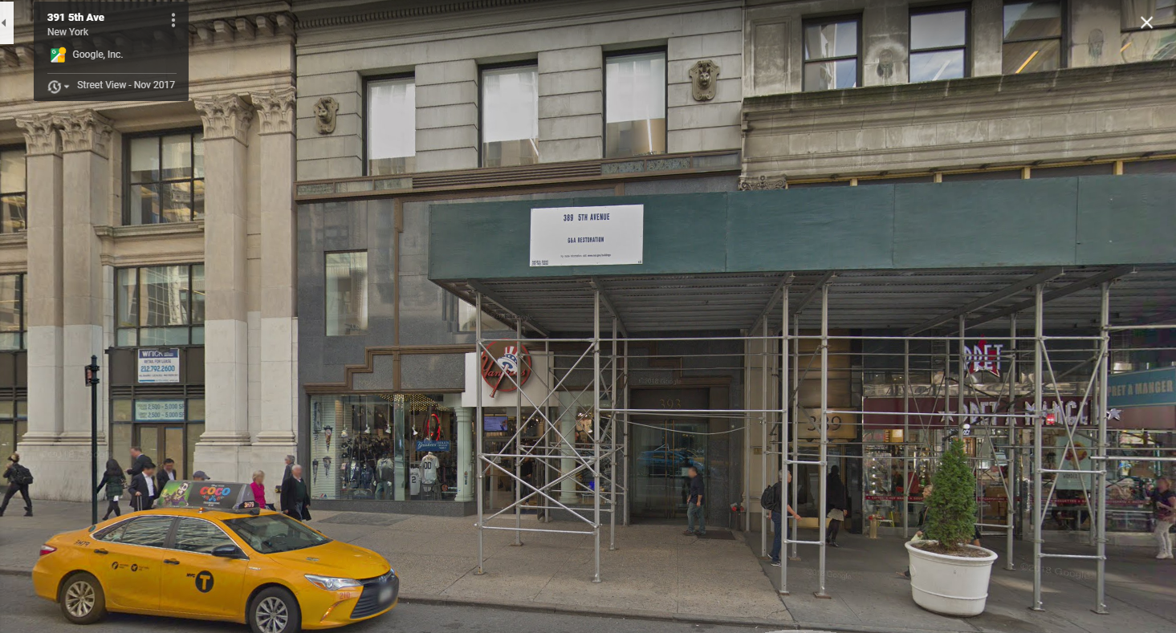
Datos Tabulados (Relacional) y Joins / Lookups (ej. Web Services)
New York Taxi Data
Datos de geocodificación inversa
vista de calle
Notes:
You can go even further and use Google maps to visualize the location (see here that there is even a taxicab in the image!)
https://data.cityofnewyork.us/Transportation/2015-Yellow-Taxi-Trip-Data/ba8s-jw6u

Slide 21
Qué hace a los Datos “Big” Data?
Un gigabyte? Un petabyte? Un yottabyte?
Un Millón de registros? Un Billón de registros? Un Trillón de registros?
No existe una definición de consenso, pero desde nuestra perspectiva :
Demasiado complejo para que un humano lo entienda directamente
No cabe en un único espacio de memoria uniforme (por ejemplo, variables en Python), lo que significa que debemos pensar detenidamente sobre la E/S y/o la comunicación.
Necesita más que algoritmos de fuerza bruta para analizar
Puede requerir que varias computadoras trabajen en paralelo para procesar
Posiblemente alta dimensionalidad, requiriendo selección de características y reducción de dimensionalidad
Puede estar cambiando rápidamente (alta velocidad)
Notes:
In Data Science, the focus is on Big Data.
So what is it that really makes data “big”? Of course the size matters: it may be too big for an Excel spreadsheet, or too big for the main memory in your computer. But It is also the heterogeneity of data (e.g. data being combined from images, free text and structured sources), and the fact that the data may also be rapidly changing or streaming, requiring a different type of processing.
Even if we focus just on size, there are issues that must be addressed: Observe that size is affected by both the number of rows (or observations) as well as the number of columns (or features). When the number of rows is very big, you cannot just use a brute force or naïve algorithm, you have to worry about efficiency; it may also require you to use parallelism to speed up computation. When the number of columns is big, you may have to reduce the number of features using feature selection and dimensionality reduction. These ideas will be discussed in detail later, but:
Feature Selection is the process where you automatically or manually select those features which contribute most to your prediction variable or output in which you are interested.
Dimensionality reduction is the process of reducing the number of random variables under consideration by obtaining a set of principal variables.

Slide 22
¿Qué implica Data Analytics?

Slide 23
El Objetivo de Data Analytics: De Datos al “Conocimiento” o Acción
Detección de Patrones : Datos Duros ⇒ Patrones ⇒ Comprensión Parcial
“Mostrar las ventas por región por categoría de producto”
“Mostrar grupos de documentos por concepto”
“Cubos de Datos” (ventas por región por trimestre por tipo de producto)
Normalmente, estadística descriptiva
Dada una observación: Hipótesis ⇒ experimentar sobre muestra ⇒ significado
“El factor conductual F conduce a un mayor riesgo de resultado O”
Hacer una prueba estadística, medición del significado frente a la hipótesis nula
Normalmente, inferencia estadística
Notes:
Once you have something in a form that it can be read, the next step is to understand the data and look for patterns. You may do this by hand, or use visualization tools to get an idea of what the data is about.
Once you understand more about the dataset, you make a hypothesis. To test the hypothesis you may need to obtain additional data (find/collect more data, run an experiment that generates more data about the truth of the hypothesis).
Finally you use statistics and test if the hypothesis is valid.
The typical pipeline is at the bottom of the page. Sometimes the apply step is linked back to the collection step, and ends at the extrapolate step. ML is in the recognize and build steps.

Slide 24
Qué involucre Big Data Analytics?
Adquisición, acceso – los datos pueden existir sin ser accesibles
Limpiar y unificar – los datos pueden estar en forma incorrecta
Integración, representación – es posible que no se capturen las relaciones de datos
Limpieza, filtrado – los datos pueden tener calidad variable
Definir Hipótesis, consultar, analizar, modelar– de los datos a la información
Comprender, iterar, explorar– ayudando a construir conocimiento
Y: obligaciones éticas – necesidad de proteger los datos, seguir buenas prácticas estadísticas, presentar resultados de una manera no engañosa
Notes:
Some of the activities involved in analytics are listed here, annotated with the steps in the pipeline in which they appear.
And a very important part of analytics are the ethical issues, which must be considered at each step along the way in this pipeline.
The last issue is what questions should I be asking? What applications make sense? It is easy to get data, but hard to do something useful with it.

Slide 25
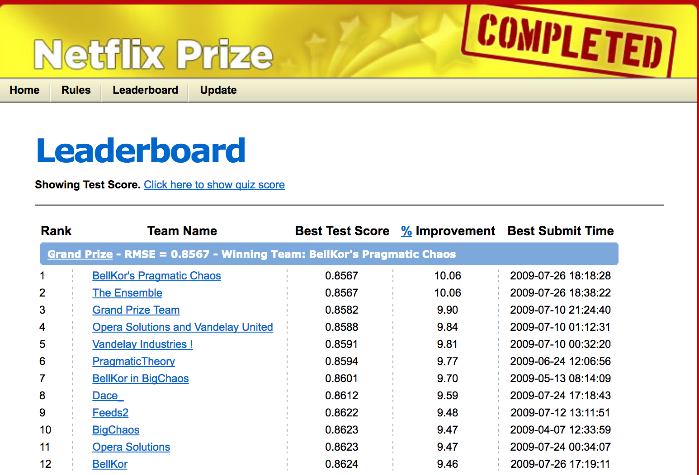
Ejemplo: recomendación de Netflix (o Amazon, o búsqueda personalizada, o…)
Notes:
One of the first data science problems posed to the community at large, from about a decade ago, was called the “Netflix Prize.”
Netflix wanted to improve video recommendations for their customers.
Netflix shared “anonymized” data with the public and asked for solutions, with a $1M prize. At that point, users would rate a movie from 1-5 stars.
There was a lot of available data here: structured information about the movies, titles, actors, other people’s ratings, text descriptions, and so on. Each person working on the challenge extracted different “features” used them in various ways to make predictions, using techniques from natural language processing (over text), machine learning, and a related technique called collaborative filtering.
But the Netflix Challenge ultimately revealed another issue that we always need to consider in the data science space: it turned out that clever researchers were able to correlate the anonymous Netflix viewership information with reviews posted (with IDs) to the Internet Movie Database, and reverse engineer who many of the viewers were!
So in many ways the Netflix Challenge is a microcosm of the kinds of issues one encounters in data science: techniques to extract the right features, techniques for machine learning, computing at very large scale, and being very cognizant of data privacy and other ethical issues.

Slide 26
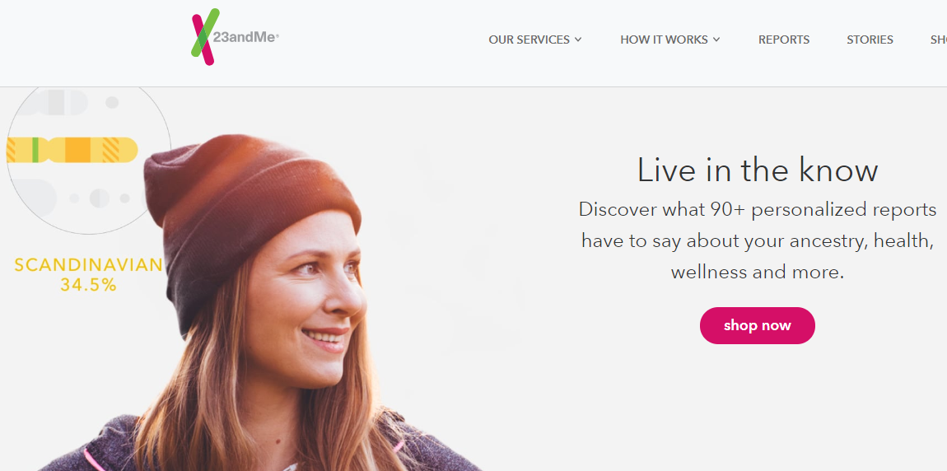
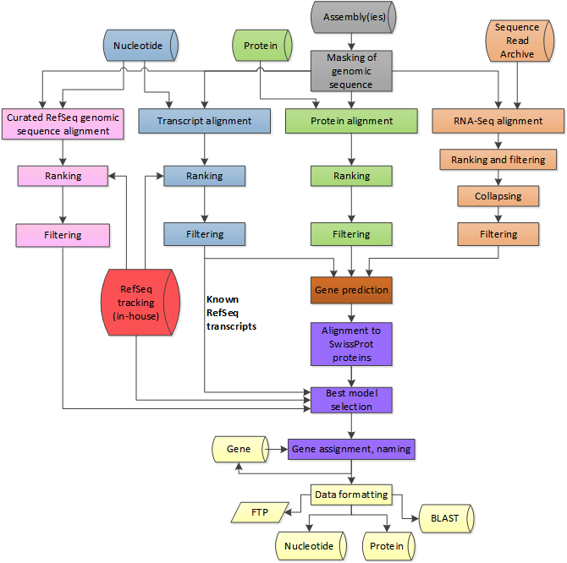
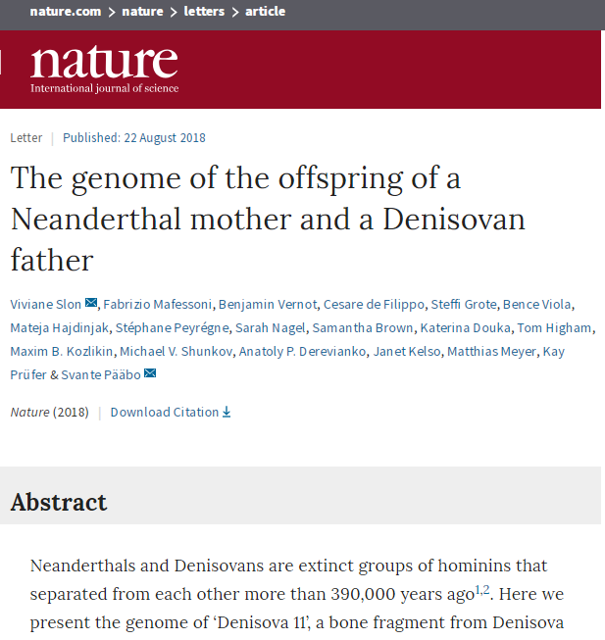
Ejemplo: secuenciación de genes de alto rendimiento
23andme.com
https://www.ncbi.nlm.nih.gov/genome/annotation_euk/process/
Notes:
As another example, Genomics (computational biology) was an early example of Data Science. It was the “putting a man on the moon” grand challenge of the 1990’s. Over the decades, innovations in technologies to collect genomic information have provided a tremendous amount of data, and algorithms and techniques have been developed for its analysis. This was a precursor for what is now happening in many different fields across humanities, political science, economics, etc.
High-throughput gene sequencing allows us to capture vast amounts of DNA and use it to do interesting things, e.g. the types of analysis that is being performed by companies such as 23andme.
This information also enables other things, such as personalized medicine (i.e. developing treatment plans for individuals rather than a generic treatment plan).
An example of the pipeline for its analysis is shown on the right, which performs the wrangling discussed earlier, align with other data banks, and make predictions.

Slide 27
Data Science / Data Analytics: Tener cuidado con las expectativas exageradas!
Mitos Data science:
Aprenderemos todo "de abajo hacia arriba" utilizando estadísticas sofisticadas y machine learning
Básicamente, "giramos la manivela" y sacamos información!
Datos + Algoritmos 🡪 Conocimiento
Realidad Data science:
Por lo general, confiamos en la experiencia humana para imponer modelos sobre los datos, las funciones, etc.
Deep learning puede hacer una selección de funciones, pero ¿por qué desechar lo que sabemos?!
Datos + percepción humana + algoritmos + iteración → información → conocimiento
Notes:
Data science requires human insight, in particular by the domain scientist. It is not just turning the crank using statistics and machine learning!

Slide 28
Proceso de Data Science
Que preguntas se debe responder?
Cuál es el alcance adecuado del proyecto?
Qué datos deben usarse?
Qué tecnicas se aplicarán?
Cómo se evaluarán los resultados?
Qué mantenimiento será necesario?
Notes:
Here are things that you should consider when embarking on a data science project.

Slide 29
Resumen

Slide 30
Unas palabras de los profesionales de Data Science
Al menos el 80-90% de su trabajo no implica machine learning, pero:
Trabajar con expertos para comprender el dominio, suposiciones, preguntas, etc..
Tratar de catalogar y dar sentido a las fuentes de datos
Limpiar, unificar, extraer e integrar los datos
Limpiar los datos ajustados

Slide 31
Qué implica Data Science
Los datos son de alta dimensión, difíciles de entender y requieren una comprensión de los costos de computación y E/S.
Dado un conjunto de datos integrado (¡a menudo la parte difícil!), data science Implica extraer y seleccionar características, así como agregar estructura semántica a los datos.
Hay muchas aplicaciones de Data Science, desde el descubrimiento hasta la agrupación, la clasificación y la recomendación!
A veces estadística, a veces algorítmos y, a veces, dependiente de la extracción

